Slide 1
Medical Cost Personal Datasets Insurance Forecast
Made by
Joyita Hazra

Slide 2
OBJECTIVE
Health insurance provides access to and financial protection against medical costs in the event of an accident, injury or diagnosis of a chronic illness that requires ongoing treatment by a specialist.
Medical coverage also protects individuals who need immediate care for a broken leg, stroke or heart attack.

Slide 3
ABOUT DATA
Here, Target feature is Charges which is dependent on other features i.e. Age, Sex, BMI, Children, Smoker, and Region.
In Sex, F denotes Female and M denotes Male.
In Region, SW denotes Southwest, SE denotes Southeast, NW denotes Northwest, NE denotes Northeast.
Based on this data, we can also create new features for representing the existing features in a modified way.
Age | Sex | BMI | Children | Smoker | Region | Charges
19 | F | 27.9 | 0 | yes | SW | 16884.92
18 | M | 33.77 | 1 | no | SE | 1725.552
28 | M | 33 | 3 | no | SE | 4449.462
33 | M | 22.71 | 0 | no | NW | 21984.47
32 | M | 28.88 | 0 | no | NW | 3866.855

Slide 4
ANALYSIS
The new charges are set based on Age, BMI, Number of children, Smoking.
As per New Charges, maximum charge will be provided to maximum age person(e.g. 46) and minimum charge is provided to minimum age person(e.g. 19).
If 2 people have same age, then new charges will be predicted based on their BMI and children. The person with less BMI will get more charge since he/she is having more children than the other.
Age | Sex | BMI | Children | Smoker | Region | Charges | New Charges
19 | F | 27.9 | 0 | yes | SW | 16884.92 | 17884.92
32 | M | 28.88 | 0 | no | NW | 3866.855 | 20386.85
46 | F | 33.44 | 1 | no | SE | 8240.59 | 32435.89

Slide 5
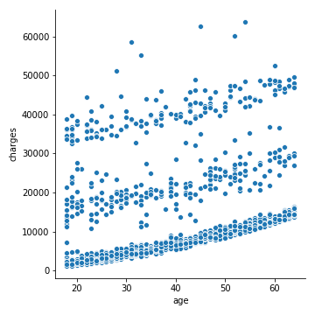
EDA
Inference:
By seeing this visualization, we can say that more number of people are getting medical charges in 2 groups: 1st between 0- 5000 and 2nd between 12000-25000.
Also we can see that most of the people are getting medical charges are divided into 3 groups: 1st between 0-5000, 2nd between 12000-20000, 3rd between 33000-40000.

Slide 6
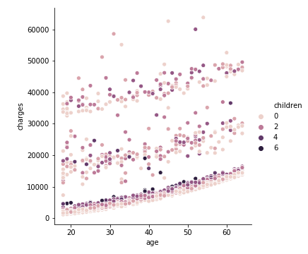
Inference:
By seeing this visualization, we can say that most of the people don't have children and least number of people have 6 children.

Slide 7
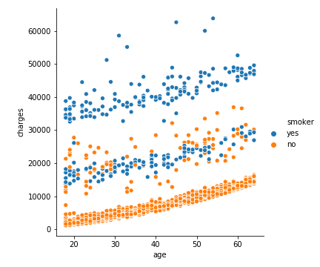
Inference:
by seeing this visualization, we can say that smokers are getting more medical charges compared to non-smokers, i.e. they are more prone to diseases.
Most of the smokers are getting medical charges between 32000-40000 and most of the non-smokers are getting between 0-10000.

Slide 8
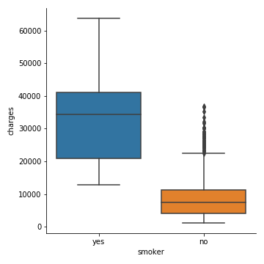
Inference:
by seeing this visualization, we can observe that most of the smokers are getting medical cost billed by health insurance between 20000-40000 whereas most of the non-smokers are getting medical charges between 0-10000.
we can conclude that individual medical cost billed by health insurance is more for smokers compared to non-smokers.

Slide 9
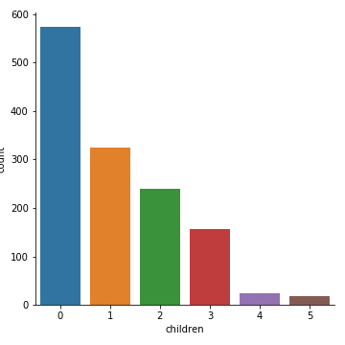
Inference:
by seeing this visualization, we can say that number of people with more number of children is inversely proportional to number of children
maximum people don't have children and least number of people have 5 children.

Slide 10
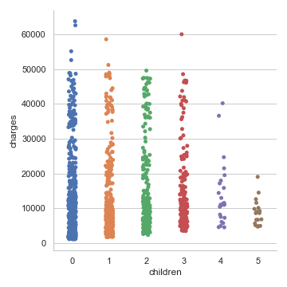
Inference:
by seeing this visualization, we can observe that the amount of individual medical cost billed by health insurance is reducing with increase in number of children.

Slide 11
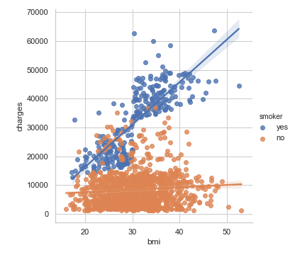
Inference:
by seeing this visualization graph we can say that, most of the people are having BMI between 22-37
they are getting medical charges between 0-10000
all of them are non-smokers.

Slide 12
Feature Engineering
As per the analysis, Age can be categorized into 3 groups ie. Youth (16-30), Adult (31-45), Middle-Aged (46-60), Old (61-75).
Ideal BMI is (18.5-24.9), hence BMI can also be categorized into 3 parts i.e. Ideal, Underweight (below Ideal), Overweight (above Ideal)
These modifications may provide better outcomes and help in predicting the target feature properly.
age | sex | bmi | children | smoker | region | charges | Age_Groups | BMI_Range
19 | F | 27.9 | 0 | yes | SW | 16884.92 | Youth | Overweight
18 | M | 33.77 | 1 | no | SE | 1725.552 | Youth | Overweight
28 | M | 33 | 3 | no | SE | 4449.462 | Youth | Overweight
33 | M | 22.71 | 0 | no | NW | 21984.47 | Adult | Ideal
32 | M | 28.88 | 0 | no | NW | 3866.855 | Adult | Overweight

Slide 13
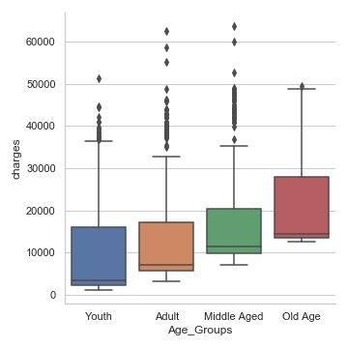
Inference:
by seeing this graph, we can say that maximum charges are claimed by old age people (15000-28000). That means old aged people are more prone to diseases or loss of life
youth are claiming charges between 3000-16000
Adults are claiming charges between 7000-17000
Middle-aged people are claiming charges between 10000-20000

Slide 14
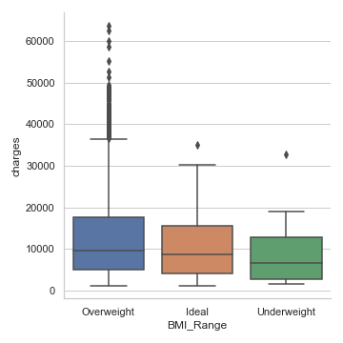
Inference:
By visualizing this graph, we can say that Maximum medical charges are claimed by over-weight people (5000-18000)
least medical charges are claimed by under-weight people(2000-12000)
Maximum people in this dataset are over-weight.

Slide 15
Machine Learning
Here 3 machine learning algorithms has been used and they are as follows
- Linear Regression
- K Nearest Neighbor (KNN)
- Decision Tree
With Linear Regression, Root Mean Square Error = 5685.5859
With KNN, Root Mean Square Error = 5109.5501
With Decision Tree, Root Mean Square Error = 7643.20356
Hence, we can conclude that we are getting best results from KNN Algorithm.

Slide 16
CONCLUSION
As per EDA, we can conclude that the Target feature is majorly dependent on features Age, Smoker, Children
As per the visualization, it is clearly visible that Sex, BMI, Region features are not affecting the Target Feature (Charges) much.
Based on feature engineering, we can observe that maximum people claiming for medical insurance are old-aged people and over-weight people.
We can conclude that we are getting best results from KNN Algorithm since it is giving Minimum Error Value.

Slide 17
THANK YOU

